Slide 1
Test Management
Christopher Parnin

Slide 2
Types of Testing
•Unit Testing
•Individual component (class or subsystem)
•Carried out by developers
•Goal: Confirm that the component or subsystem is correctly coded and carries out the intended functionality
•Integration Testing
•Groups of subsystems (collection of subsystems) and eventually the entire system
•Carried out by developers
•Goal: Test the interfaces among the subsystems.

Slide 3
Types of Testing
•System Testing
•The entire system
•Carried out by developers
•Goal: Determine if the system meets the requirements (functional and nonfunctional)
•Acceptance Testing
•Evaluates the system delivered by developers
•Carried out by the client. May involve executing typical transactions on site on a trial basis
•Goal: Demonstrate that the system meets the requirements and is ready to use.

Slide 4
Unit Testing Motivation
NASA Mars Climate Orbiter destroyed due to incorrect orbit insertion (September 23, 1999)
•Reason: Unit conversion problem.
Refactoring support
Agile: Deliver Story+Unit Tests
Part of DevOps infrastructure.
G...+ interview question: Write unit tests for this class: StopWatchTimer.

Slide 5
Unit Testing Methods
•Static Testing (at compile time) (later lecture)
•Static Analysis
•Review
•Walk-through (informal)
•Code inspection (formal)
•Dynamic Testing (at run time)
•Black-box testing
•White-box testing. (later lecture)

Slide 6
Black Box Testing
•Focus: I/O behavior
•If for any given input, we can predict the output, then the component passes the test
•Requires test oracle
•Goal: Reduce number of test cases by equivalence partitioning:
•Divide input conditions into equivalence classes
•Choose test cases for each equivalence class.

Slide 7
Black Box Testing
Input is valid across range of values
•Developer selects test cases from 3 equivalence classes:
•Below the range
•Within the range
•Above the range
Input is only valid, if it is a member of a discrete set
•Developer selects test cases from 2 equivalence classes:
•Valid discrete values
•Invalid discrete values

Slide 8
Black box Activity
public class MyCalendar {
public int getNumDaysInMonth(int month, int year)
throws InvalidMonthException
{ … }
}
Representation for month:
1: January, 2: February, …., 12: December
Representation for year:
1904, … 1999, 2000,…, 2006, …
How many test cases do we need for the black box testing of getNumDaysInMonth()?

Slide 9
Mocking
Create Mock Objects to avoid dependency on other systems (database, filesystem).
Services (3rd party)
Use tools or hand-coded data.
Previous mocking workshop
https://github.ncsu.edu/CSC510-Fall2014/UnitTesting/

Slide 10
Testing at Google
Software development at Google is big and fast. The code base receives 20+ code changes per minute and 50% of the files change every month!
John Penix: http://www.infoq.com/presentations/Continuous-Testing-Build-Cloud

Slide 11
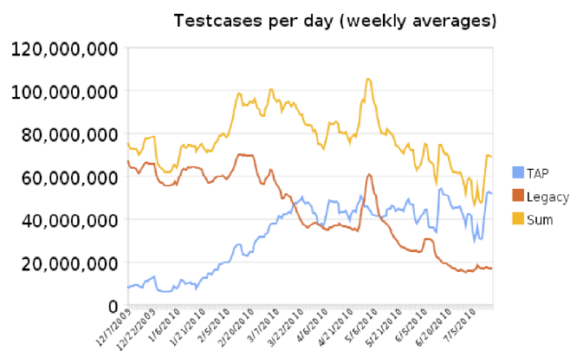
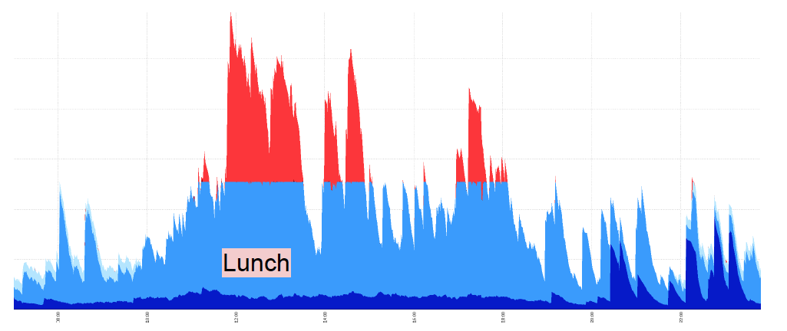
Load
20 Million+ builds per year
60 Million+ test cases
10000 cores + 50TB

Slide 12
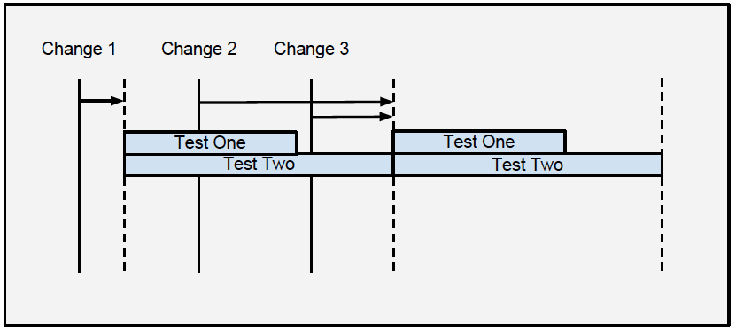
Test Prioritization
Some tests may take long...but not find bugs...

Slide 13
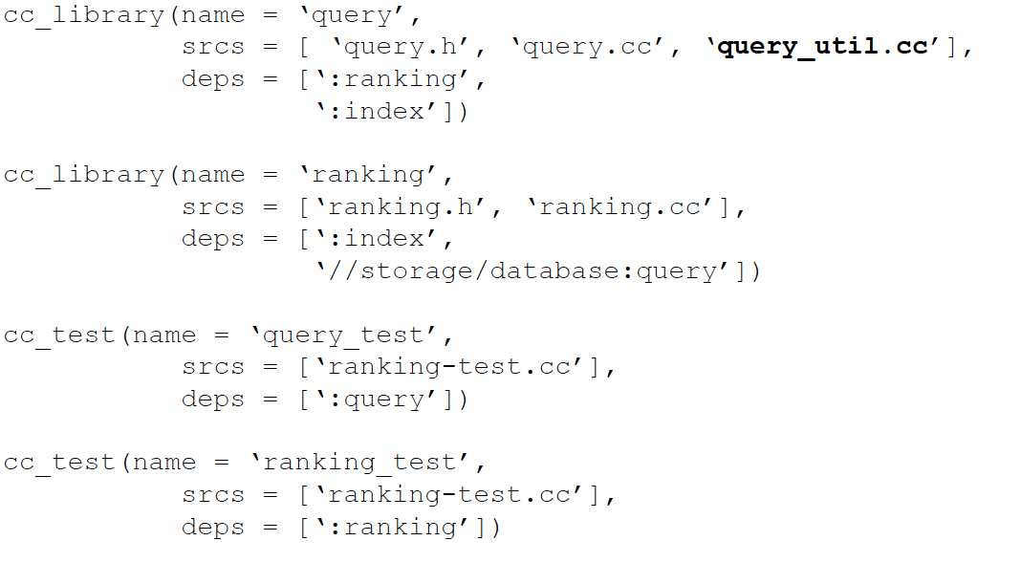
Build analysis
A system that uses dependency analysis to determine all the tests a change transitively affects and then runs only those tests for every change.
-- Google
Alternatively, co-change analysis
http://sail.cs.queensu.ca/publications/pubs/icsme2014-mcintosh.pdf

Slide 14
Test Generation
Randoop
http://people.csail.mit.edu/cpacheco/publications/randoopjava.pdf
EvoSuite
http://www.evosuite.org/
PEX
http://research.microsoft.com/en-us/projects/pex/

Slide 15
PEX for Fun
http://www.pexforfun.com/

Slide 16
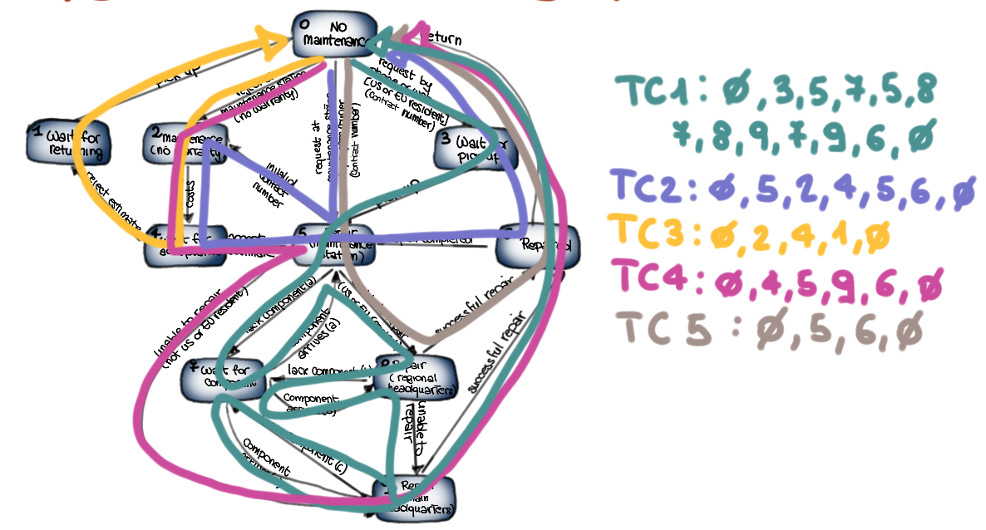
Coverage-based test analysis

Slide 17
White-box Testing
http://measure.cc.gt.atl.ga.us/classes/cs6300/Lectures/class18testing.pdf

Slide 18
More
Bug Prediction at Google:
http://google-engtools.blogspot.com/2011/12/bug-prediction-at-google.html

